Slide 1
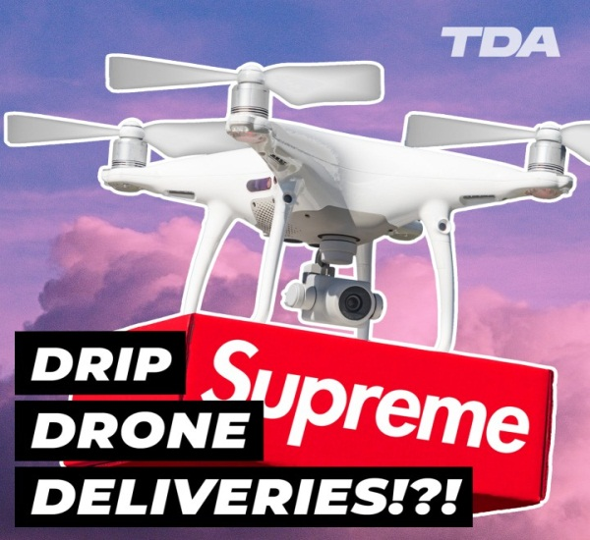
Delivery by Drone
Student’s Name
Institution

Slide 2
Table of Content
Introduction
Drones and Cost-Effectiveness
Comparison of Delivery
Convenient and Safe
Efficiency in Logistics and Supply Chain
Obstacles to Drone Delivery
Conclusion
Reference

Slide 3
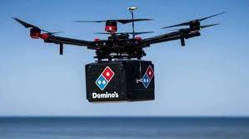
Introduction
Drone technology is revolutionary
Logistics and supply chain
Part of company operations
More companies appreciates its significance
Faster and more convenient
Helping save the planet
Online shopping experience
Notes:
This presentation highlights the significance and importance of drones as a delivery medium. With the purchasing behavior of customers changing, delivery by drones is becoming the order of the day. Many companies, especially those in the online retail businesses such as Amazon, e-Bay, and others are finding it useful and cost effective using drones to deliver products to clients who have made purchases from their homes. Some of the potential benefits discussed in this report include cost effectiveness, convenient and safe, reduces emission in the atmosphere, and improving the logistic and supply chain management.

Slide 4
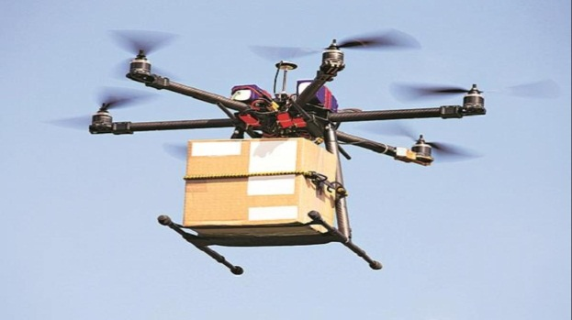
Drones and Cost-Effectiveness
Drones are cost-effective
It reduces the shipping costs
It also reduces the operational costs
Online retail platforms like Amazon already experimenting the drone delivery
This would cost customers about $1
Delivery takes about 30 minutes or less (Sunol, 2020)
Notes:
One of the potential benefits that make businesses, especially online retailing shops like Amazon to run to drones is its cost reduction benefits. According to Sunol (2020), business reports have shown that online retailers like Amazon could potentially reduce their shipping and operational costs if they adopt drone delivery methods. With an estimated delivery cost of $1 in 30 minutes or less, business will be able to minimize their operational costs while improving their profitability.

Slide 5
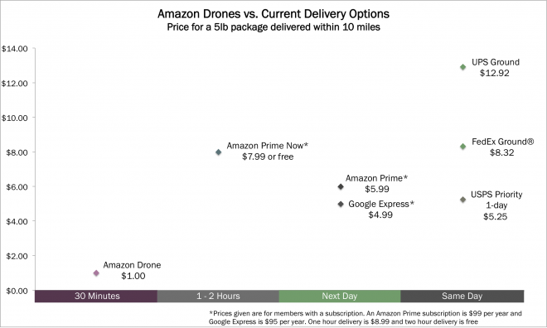
Comparison of Delivery
Amazon drones are delivering products faster (https://www.youtube.com/watch?v=3HJtmx5f1Fc)
The chart below shows that comparison with other drones
Amazon’s cost is relatively cheaper
UPS Ground ($12.92)
Fed Ex Ground ($8.32)
Google Express ($4.99)
Amazon Drone ($1.00)
Notes:
The above comparison shows the potential cost-reduction benefits that drone deliveries would bring to the organizations that adopt it. Compared to the other players in the market, Amazon’s drone delivery is relatively cheaper (at $1.00 ) and the product gets delivered within 30 minutes or less. No customer would want anything less than faster delivery

Slide 6
Convenient and Safe
Delivering products is challenging
It is associated with many challenges
Such as security threats
Drones are operated at the comfort of office
The product is on air and reaches to customer on time (Goodchild & Toy, 2018)
There is no traffic or delays due to unnecessary stops
Notes:
Drones are becoming revolutionary in the way they help minimize some of the liabilities that companies have incurred for many years. These challenges range from security threats to inconveniencies in the delivery due to logistical challenges resulting in delays. Traffic is one such logistical issue that many companies have faced. With the emergence of drones, these problems are becoming a problem of the past because drones can be flown by someone who is in the office and the product reaches the customer within the shortest time possible.

Slide 7
Reducing Emissions
The world is grappling with the effects of climate change
Greenhouse gas emissions (Yoo et al., 2018)
Every contribution is important
Vehicles and motorcycles are increasing emissions
Drones are the solution with no emission (Stolaroff et al., 2018)
Notes:
Drones are becoming the solution or part of the solution to a problem that has given many governments headache. Reducing emissions is a great challenge that even the United States is yet to reconcile with. Deliveries using vehicles and motorcycles are increasing the risks of increasing emissions in the atmosphere. Drones are the solution to this problem because they emit no gases. Some of the are sophisticated that they can use energy from lithium batteries while others use solar. This will minimize the number of vehicles on the road, thus, reducing emission problem

Slide 8
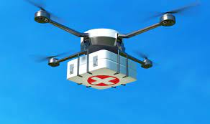
Efficiency in Logistics and Supply Chain
Ability to overcome human-based delivery challenges
Big-data resolves the human inefficiency
Great precision determines exact time for each delivery (Shearer & Moss, 2020)
Customers do
not have to wait
Reduces uncertainty
of delays in delivery
Notes:
Drone delivery is changing the logistic and supply change management. Drones are associated with efficiencies that human-based delivery is associated with such as uncertainties and delays in time and even place. However, with the right precision and correct data, companies can calculate and get the exact location and time of delivery. As Shearer and Moss (2020) explain, drone delivery is the solution to these uncertainties linked to human-based delivery.

Slide 9
Obstacles to Drone Delivery
Technology is already developed
It is not yet acceptable
Regulatory agencies are yet to approve the use
Hurdles like privacy laws
Security and safety risks
Susceptibility to hacking
Collision liability and high insurance costs
Notes:
Even though many companies have experimented and highlighted the benefits of drones in delivery, a lot needs to be done to ensure that they can operate effectively. The use of drones is associated with many challenges and hurdles, as highlighted in this slide. These include susceptibility to hacking, collision liabilities, and lack of regulations by the regulatory agencies makes it difficult for companies to utilize and rip the benefits of this technology.

Slide 10
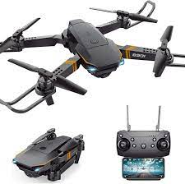
Conclusion
Drone technology is revolutionary
Changing supply chain management
Reduces delivery time
Human-related inefficiencies
Many hurdles including:
Lack of regulatory guidelines
Exposure to security threats
High insurance costs
Notes:
Drone technology is revolutionary, especially in logistic and supply chain management. Many companies that rely on delivery and transportation are expressed the potential benefits with the drone delivery technology. Despite the potential benefits it presents, drone technology is still facing various hurdles including lack of proper regulatory system and high insurance costs, which may increase the cost of operations that companies are trying to reduce.

Slide 11
References
Goodchild, A., & Toy, J. (2018). Delivery by drone: An evaluation of unmanned aerial vehicle technology in reducing CO2 emissions in the delivery service industry. Transportation Research Part D: Transport and Environment, 61, 58-67.
Shearer, N., & Moss, R. (2020, June 25). “Researchers say drone technology will change the face of last-mile logistics.” Nevada Today (online). https://www.unr.edu/nevada-today/news/2020/drone-technology-impacts-last-mile-logistics
Stolaroff, J. K., Samaras, C., O’Neill, E. R., Lubers, A., Mitchell, A. S., & Ceperley, D. (2018). Energy use and life cycle greenhouse gas emissions of drones for commercial package delivery. Nature communications, 9(1), 1-13.
Sunol, H. (2020, November 6). “How Drones will affect the Logistics industry in the Next 5 years.” Cyzerg (online). https://articles.cyzerg.com/how-drones-will-affect-the-logistics-industry-in-the-next-5-years/
Yoo, W., Yu, E., & Jung, J. (2018). Drone delivery: Factors affecting the public’s attitude and intention to adopt. Telematics and Informatics, 35(6), 1687-1700.

